Slide 1
Demographic & Epidemiological Analysis based on selected measures from East Asian Context
Group E

Slide 2
Countries in East Asian Region

Slide 3
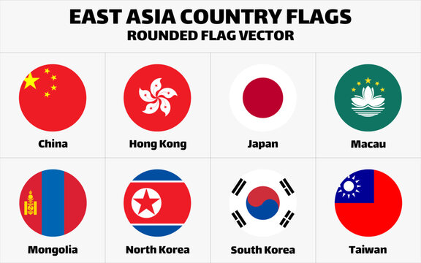
China
China has free public healthcare which is under the country's social insurance plan. The healthcare system provides basic coverage for the majority of the native population. China's healthcare has shifted from treatment to prevention, focusing on preventing lifestyle-related illnesses such as diabetes, cancers, and cardiovascular disease.

Slide 4
Japan
Health care in Japan is provided free for Japanese citizens and foreigners. Medical treatment in Japan is provided through universal health care. This system is available to all citizens, and non-Japanese citizens staying in Japan for more than one year.

Slide 5
North Korea
The North Korean government claims that its healthcare system is free for all, but in reality, payment has been required for all services.
Doctors are usually paid in cigarettes, alcohol or food for basic consults and taking cash for anything else, like tests or surgeries.

Slide 6
South Korea
The system is funded by a compulsory National Health Insurance Scheme that covers 97% of the population. Foreign nationals living in South Korea receive the same facilitates as local people. The healthcare system and health insurance in South Korea is extremely high quality.

Slide 7
Mongolia
Mongolia provides free and universal healthcare to its citizens. The availability of basic healthcare services within certain facilities is not sufficient. Readiness is stunted by a lack of diagnostic capacity and a lack of medicine.

Slide 8
Demographic
Descriptive Analysis
of
Eastern Asia

Slide 9
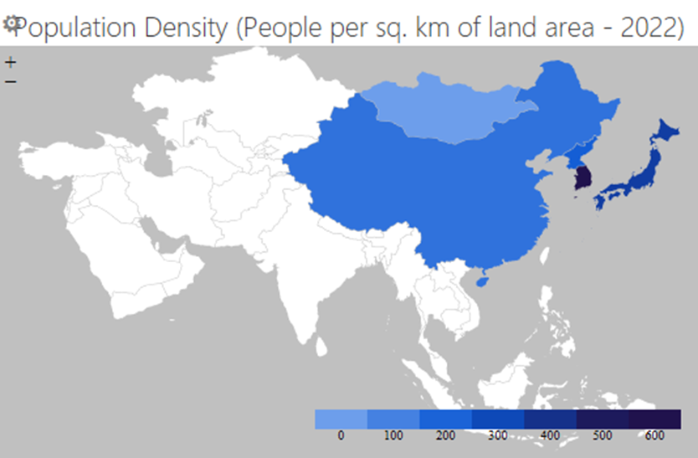
Population Density
A population per unit land area is highest in South Korea and lowest in Mongolia.

Slide 10
Population Growth
Population growth is the annual increase in the population size. Mongolia shows the highest population growth of 1.609 in 2021. China shows the lowest growth of 0.089.

Slide 11
Net Migrants
The net migration rate is the difference between the number of immigrants and the number of emigrants throughout the year. China shows the highest value of which is a negative value, which means the number of emigrants leaving the area is really higher than the number of immigrants entering in 2021. Japan shows the highest positive value in 2021, that means the number of immigrants entering the is really higher than the number of emigrants leaving the area. Mongolia shows the 0 Net Migration in 2021.

Slide 12
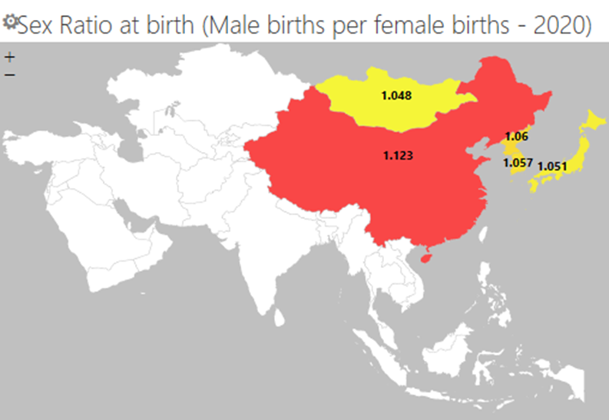
Sex Ratio
The Sex Ratio which is the ratio of males to females in a population is considerably high in China compared to the other countries.

Slide 13
Life Expectancy at birth
Life expectancy at birth indicates the number of years a newborn infant would live if prevailing patterns of mortality at the time of its birth were to stay the same throughout its life. All 5 countries show slight increasing Life expectancy at birth with years. But in North Korea in 1993 there is drop of Life expectancy at birth by approximately 10 years. Starting from 2002 Life expectancy at birth again increase over the time. Japan shows the high Life expectancy at birth throughout all the years.

Slide 14
Child Dependency Ratio
The number of children aged 0-14 per 100 persons aged 15-64 is highest in Mongolia.
It shows a lot higher Rate compare to other 4 countries. South Korea shows the lowest Child Dependency Ratio.

Slide 15
Aged Dependency Ratio
Aged dependency Ratio is the ratio of dependents people older than 64, to the working age population, those ages 15-64. Aged dependency Ratio of Japan is strictly increasing over the time compared to other countries. Aged dependency Ratio of Mongolia is decreasing over the time since 1960 to 2003 then slightly increase by 2020. Japan shows the highest Age Dependency Ratio of 50.97 in 2020. Other countries show slightly increasing Aged Dependency Ratio over the time.

Slide 16
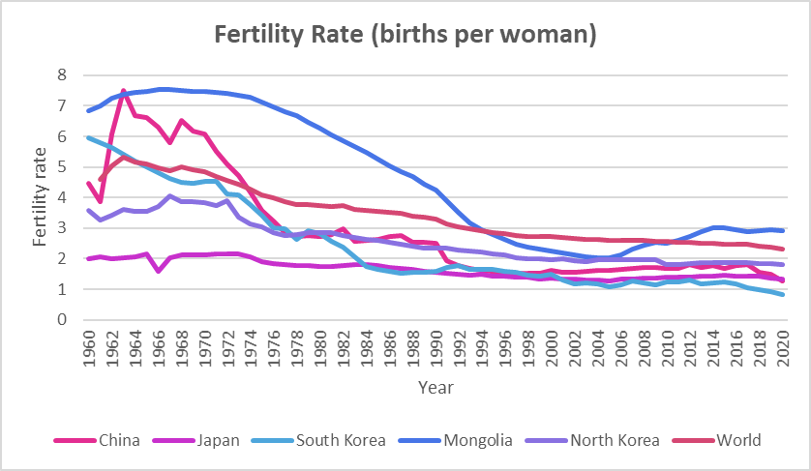
Age Specific Fertility Rate
Average number of children that would be born to a woman over her lifetime is higher most of the years in Mongolia compared to the other 4 countries. Rate becomes lower than the world fertility rate only for 1994 to 2010 but it still has the highest rate compare to the other countries in 2021. All 5 countries fertility Rate decrease over the time. South Korea had a high fertility Rate than China, Japan, North Korea and the world in 1960 but now South Korea shows a lowest Fertility Rate of 0.837. China shows a highly fluctuating fertility since 1961 to 1979.

Slide 17
Mortality Rates
Adult Mortality Rate (15 – 64)
The Adult Mortality Rate is the probability of dying between the ages of 15 and 60. In the East Asia region, the adult mortality rate of male is higher than for female. In 2019, Mongolia has the highest male adult mortality rate, which is nearly 255 deaths per 1000 male adults. North Korea has the highest female adult mortality rate, which is nearly 108 deaths per 1000 female adults.

Slide 18
Under 5 Mortality Rate
(per 1000 live births)
The Under-Five Mortality Rate is the probability per 1,000 that a newborn baby will die before reaching the age of five. It has been decreasing over time in recent years.

Slide 19
North Korea has the highest under 5 mortality rate compared to other countries in the East Asia region considering both genders in 2020. For males nearly 18 deaths per 1000 male live births and for females nearly 15 deaths per 1000 female live births.

Slide 20
Infant Mortality Rate
The Infant Mortality Rate is the number of infants dying before reaching one year of age per 1000 live births in a given year. Over the recent years, the infant mortality rate has declined.

Slide 21
Mongolia has the highest number of infant mortality rate for both male and female in 2020. For male 15 deaths per 1000 male live births and 12 deaths per 1000 female live births approximately. Also, under 5 mortality rate in North Korea is much higher than in South Korea, considering both genders.

Slide 22
Estimated Maternal Mortality Ratio (per 100,000 live births)
The Maternal Mortality Ratio is the number of women who die from pregnancy-related causes during pregnancy or within 42 days of abortion, per 100,000 live births.
The Estimated Maternal Mortality Ratio fell by approximately half during 2000 - 2017 period. Japan has the lowest maternal mortality ratio compared to other countries in the region. In 2017, North Korea has the highest maternal mortality ratio compared to other countries in the region.

Slide 23
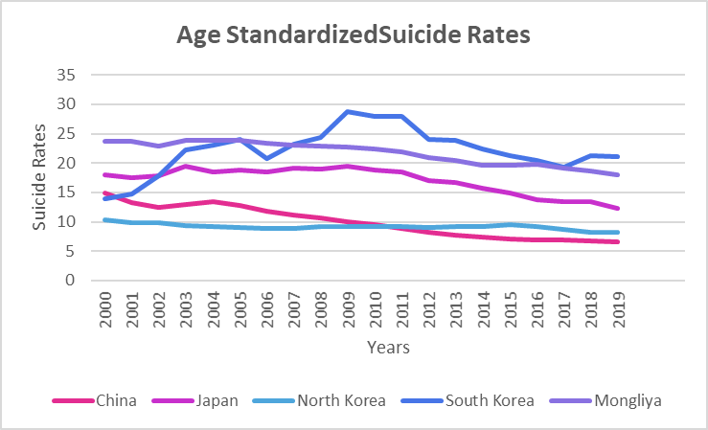
Age Standardized Suicide Rates (per 100 000 population - 2019)
South Korea shows a 13.9 of low rate of deaths from suicide and intentional self-harm per 100 000 people influenced by the age distribution, in 2000. Only North Korea had age- standardized Suicide Rate less than South Korea in that year. But South Korea reaches to the 28.78 of highest Suicide Rate in 2009 and then slightly decreased over the years. Still South Korea shows a highest Suicide Rate than all 5 countries in 2019. Mongolia shows the highest Suicide Rate in 2000 and still shows the second highest in 2019. China shows the lowest Suicide Rate of 6.67 in 2019. Mongolia, Japan, China and North Korea reach to lower Suicide Rate in 2019 than 2000.

Slide 24
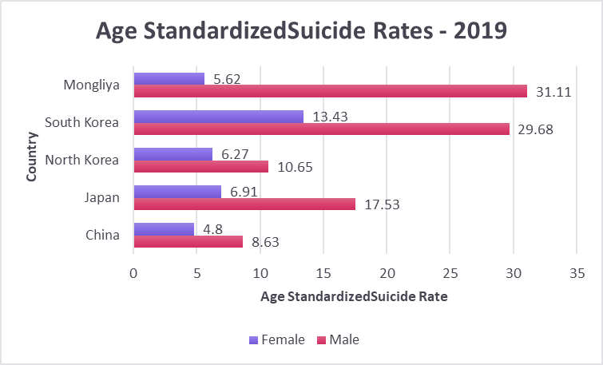
Male population shows a high Suicide Rate than females in each country. Highest male Suicide Rate reported from Mongolia whilst highest female Suicide Rate reported from South Korea.

Slide 25
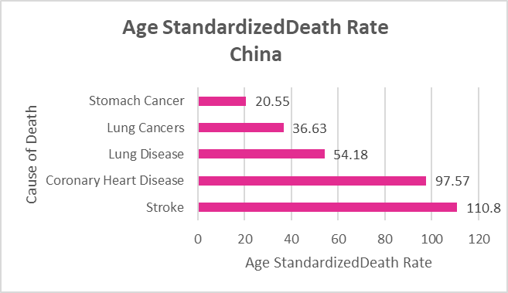
Age Standardized Death Rate by Cause
China
Cause of death | Rate | World Rank
Stroke | 110.8 | 58
Coronary Heart Disease | 97.57 | 115
Lung Disease | 54.18 | 13
Lung Cancers | 36.63 | 5
Stomach Cancers | 20.55 | 3
In China Stroke is the cause of death which gives the 110.8 of highest Age Standardized Death Rate which is the Death Rate of a population adjusted to a standard age distribution. China is at world ranking 3 and 5 for Stomach Cancers and Lung Cancers.

Slide 26
Japan
Causes of death | Rate | World Rank
Coronary Heart Disease | 30.62 | 181
Stroke | 23.21 | 161
Lung Cancers | 18.06 | 66
Influenza and Pneumonia | 16.56 | 129
Colon-Rectum Cancers | 13.59 | 37
In Japan Coronary Heart Disease is the cause of death which gives the 30.62of highest Death Rate of a population adjusted to a standard age distribution. But it still it is at 181 of good world ranking. And also the cause of death which shows the second highest Age – Standardize Death Rate in the country is also shows 161 at world ranking. It is Stroke.

Slide 27
North Korea
Causes of death | Rate | World Rank
Stroke | 162.14 | 15
Coronary Heart Disease | 105.37 | 99
Lung Disease | 87.71 | 5
Tuberculosis | 57.14 | 16
Lung Cancers | 37.7 | 4
In North Korea Stroke is the cause of death which gives the 162.14 of highest Death Rate of a population adjusted to a standard age distribution. North Korea is at world ranking 4 and 5 for Lung Cancers and Lung Disease.

Slide 28
South Korea
Causes of death | Rate | World Rank
Coronary Heart Disease | 27.78 | 183
Stroke | 25.48 | 155
Influenza and Pneumonia | 25.21 | 100
Suicide | 21.16 | 12
Lung Cancers | 20.9 | 49
In South Korea Coronary Heart Disease is the cause of death which gives the 127.78 of Death Rate of a population adjusted to a standard age distribution. But it is at 183 of world ranging for that cause. South Korea is at world ranking 12 for suicides.

Slide 29
Mongolia
Causes of death | Rate | World Rank
Coronary Heart Disease | 283.82 | 9
Stroke | 216.3 | 2
Liver Cancer | 84.53 | 1
Liver Disease | 75.19 | 2
Stomach Cancer | 28.56 | 1
In Mongolia Coronary Heart Disease is the cause of death which gives the 283.82of Death Rate of a population adjusted to a standard age distribution. And the country is at high world ranging of 9 for that cause. Mongolia is at world ranking 1 for Liver Cancer and Stomach Cancer. And at world ranking 2 for Liver Disease and Stroke. All the 5 cause of deaths which gives the high Death Rate in Mongolia ranked among 1 – 10 in the world rankings.

Slide 30
Ambient air pollution attributable Age Standardized Death Rate (per 100 000 population – 2019)
Mongolia shows the highest male and female Age – Standardize Death Rate because of outdoor environments air pollution. And Japan shows the lowest Rate for both genders.

Slide 31
Mortality Rate attributed to unsafe water, unsafe sanitation and
lack of hygiene (per 100,000 population)
Mortality rate related to unsafe water, unsafe sanitation and lack of hygiene is deaths attributable to unsafe water, sanitation and hygiene focusing on inadequate WASH services per 100,000. WASH stands for Global Water, Sanitation and Hygiene.
In 2016, South Korea has the highest mortality rate attributed to unsafe water, unsafe sanitation and lack of hygiene compared to other countries in the region. It is nearly 2 per 100,000 population.

Slide 32
Mortality rate attributed to unintentional poisoning
(per 100,000 population)
The unintentional poisoning mortality rate is the number of unintentional poisoning deaths per 100,000 population in a given year. Household chemicals, pesticides, kerosene, carbon monoxide, and medicines can cause to unintentional poisoning.
Mongolia has the highest unintentional poisoning mortality rate compared to other countries in the East Asia region in 2019. It is approximately 3 per 100,000 population.

Slide 33
Estimated Road Traffic Mortality Rate
(per 100,000 population)
Road traffic crashes are currently the leading cause of death for children and young adults in the world. North Korea has the highest estimated road traffic mortality rate in most years and Japan has the lowest estimated road traffic mortality rate throughout 2000 – 2019 years.

Slide 34
Epidemiological Descriptive Analysis of Eastern Asia
Emphasis on Anaemia, Hypertension, Tuberculosis, Obesity and Underweight

Slide 35
Indicators :
Prevalence of Anaemia
Prevalence of Hypertension
Incidence of Tuberculosis
Prevalence of Obesity among adults
Prevalence of Underweight among adults

Slide 36
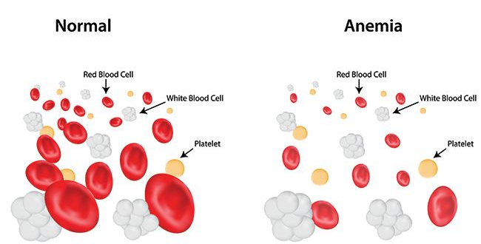
Prevalence of Anaemia (in women of reproductive age (aged 15-49) %)
Anemia is a condition in which you lack enough healthy red blood cells to carry adequate oxygen to your body's tissues. Having anemia, also referred to as low hemoglobin, can make you feel tired and weak. Anemia can be temporary or long term and can range from mild to severe. Treatments for anemia, which depend on the cause, range from taking supplements to having medical procedures. You might be able to prevent some types of anemia by eating a healthy, varied diet.

Slide 37
Year | China | Japan | South Korea | North Korea | Mongolia
2000 | 22.1 [ 14.1 – 32 ] | 21.3 [ 18.4 – 24.4 ] | 17.5 [ 14.2 – 21.2 ] | 35 [ 26.1 – 44.5 ] | 15.4 [ 9.7 – 22.9 ]
2001 | 21.1 [ 13.9 – 29.7 ] | 21.4 [ 18.6 – 24.3 ] | 17.3 [ 14 – 20.7 ] | 34.3 [ 25.8 – 43 ] | 15.5 [ 10.3 – 22.2 ]
2002 | 20.3 [ 13.9 – 28 ] | 21.4 [ 18.7 – 24.2 ] | 16.9 [ 14 – 20.3 ] | 33.7 [ 25.7 – 41.6 ] | 15.8 [ 10.8 - 21.8 ]
2003 | 19.6 [ 13.8 – 26.4 ] | 21.4 [ 18.8 – 24.1 ] | 16.7 [ 13.8 – 19.7 ] | 33.2 [ 25.5 – 40.8 ] | 16.2 [ 11.5 – 22.1 ]
2004 | 19 [ 13.5 – 25.3 ] | 21.3 [ 18.9 – 23.9 ] | 16.4 [ 13.7 – 19.2 ] | 32.8 [ 25.4 – 40 ] | 16.5 [ 11.8 – 22.2 ]
2005 | 18.3 [ 13.1 – 24.3 ] | 21.2 [ 18.8 – 23.7 ] | 16 [ 13.6 – 18.7 ] | 32.5 [ 25.1 – 39.5 ] | 16.5 [ 11.9 – 21.8 ]
2006 | 17.6 [ 12.7 – 23.4 ] | 21.1 [ 18.6 – 23.6 ] | 15.7 [ 13.4 – 18.2 ] | 32.3 [ 25 – 39.1 ] | 16 [ 11.6 – 21.8 ]
2007 | 16.9 [ 12.3 – 22.3 ] | 20.9 [ 18.5 – 23.4 ] | 15.5 [ 13.4 – 17.7 ] | 32.1 [ 25 – 39.1 ] | 15.7 [ 11.3 – 21.5 ]
2008 | 16.4 [ 11.9 – 21.4 ] | 20.6 [ 18.2 – 23.2 ] | 15.1 [ 13.2 – 17.1 ] | 31.8 [ 25 – 39 ] | 15.5 [ 11.1 – 21.3 ]
2009 | 15.8 [ 11.6 – 20.6 ] | 20.4 [ 17.9 – 22.9 ] | 14.7 [ 12.9 - 16.1 ] | 31.7 [ 25.1 – 38.9 ] | 15.1 [ 10.8 – 20.9 ]
2010 | 15.3 [ 11.3 – 19.9 ] | 20.1 [ 17.7 – 22.7 ] | 14.3 [ 12.6 – 16.1 ] | 31.6 [ 25.1 – 38.7 ] | 14.8 [ 10.4 – 20.7 ]
2011 | 15 [ 11.1 – 19.6 ] | 19.9 [ 17.4 – 22.5 ] | 14 [ 12.4 – 15.7 ] | 31.6 [ 25.1 – 38.6 ] | 14.5 [ 10.1 – 20.5 ]
2012 | 14.8 [ 11 – 19.5 ] | 19.7 [ 17.2 – 22.4 ] | 13.7 [ 12.2 – 15.4 ] | 31.7 [ 24.9 – 39 ] | 14.3 [ 9.8 – 20.5 ]
2013 | 14.8 [ 11 – 19.6 ] | 19.5 [ 17 – 22.2 ] | 13.4 [ 11.9 – 15.1 ] | 31.9 [ 25 – 39.4 ] | 14.3 [ 9.6 – 20.9 ]
2014 | 14.8 [ 10.9 – 19.7 ] | 19.3 [ 16.7 – 22.1 ] | 13.2 [ 11.7 – 14.9] | 32.2 [ 24.5 – 40.3 ] | 14.2 [ 9.2 – 21.1 ]
2015 | 14.9 [ 10.7 – 20.2 ] | 19.2 [ 16.4 – 22.1 ] | 13.1[ 11.5 – 14.8 ] | 32.5 [ 24.2 – 41.3 ] | 14.1 [ 8.9 – 21.6 ]
2016 | 15.1 [ 10.5 – 21 ] | 19.1 [ 16.1 – 22.4 ] | 13.1 [ 11.3 – 15.1 ] | 32.8 [ 23.7 – 42.8 ] | 14.1 [ 8.5 – 22.2 ]
2017 | 15.2 [ 10.1 – 22 ] | 19.1 [ 15.6 – 23 ] | 13.1 [ 11.1 – 15.4 ] | 33.2 [ 23.1 – 44.3 ] | 14.1 [ 8.2 – 23 ]
2018 | 15.3 [ 9.6 – 23.1 ] | 19 [ 15.1 – 23.6 ] | 13.2 [ 10.7 – 16.2 ] | 33.5 [ 22.1 – 46.3 ] | 14.3 [ 7.8 – 24.3 ]
2019 | 15.5 [ 9 – 24.6 ] | 19 [ 14.4 – 24.6 ] | 13.5 [ 10.3 – 17.5 ] | 33. 9 [ 21.3 – 48.4 ] | 14.5 [ 7.4 – 26 ]

Slide 38
The incidence rate gradually decreased between 2000 and 2019 in China & South Korea. Mongolia peaked in 2004, with a prevalence as percentage 16.5. Japan peaked in 2001, with 21.4 of prevalence. After 2005 , China , Mongolia & South Korea approximately same. Within the Eastern Asia, North Korea shows highest Prevalence of Anaemia, it dipped up to 2011 and then continued to rise.

Slide 39
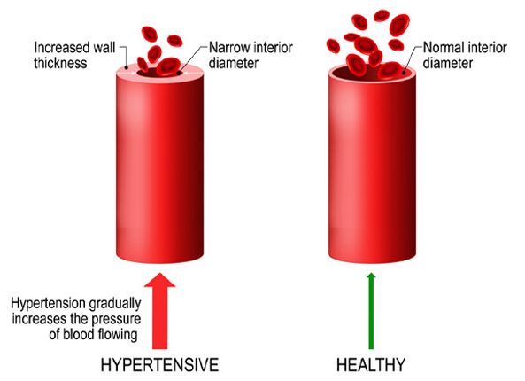
Prevalence of Hypertension ( among adults aged 30 -79 years , age standardized)
Having blood pressure measures consistently above normal may result in a diagnosis of hypertension (high blood pressure). The higher your blood pressure levels, the more risk you have for other health problems, such as heart disease, heart attack, and stroke. High blood pressure usually has no warning signs or symptoms, and many people do not know they have it. Measuring your blood pressure is the only way to know whether you have high blood pressure. People can lower their blood pressure by getting at least 150 minutes of physical activity each week ,not smoking, eating a healthy diet, including limiting sodium (salt) and alcohol, keeping a healthy weight and managing stress.

Slide 40
Year | China | Japan | South Korea | North Korea | Mongolia
2000 | 26.1 [ 24.2 – 28.0 ] | 33.8 [ 32.1 – 35.5 ] | 30.2 [ 27.7 – 32.9 ] | 25.8 [ 20.3 – 31.8 ] | 43.9 [ 39.4 – 48.4 ]
2001 | 26.5 [ 24.7 – 28.5 ] | 33.5 [ 31.8 – 35.2 ] | 30.0 [ 27.7 – 32.4 ] | 26.0 [ 20.5 – 31.8 ] | 44.2 [ 39.9 – 48.5 ]
2002 | 27.0 [ 25.1 – 28.9 ] | 33.4 [ 31.7 – 35.1 ] | 29.8 [ 27.5 – 31.7 ] | 26.1 [ 20.7 – 31.8 ] | 44.5 [ 40.3 – 48.6 ]
2003 | 27.4 [ 25.6 – 29.4 ] | 33.2 [ 31.6 – 34.9 ] | 29.6 [ 27.5 – 31.7 ] | 26.2 [ 20.8 – 31.8 ] | 44.8 [ 40.7 – 48.7 ]
2004 | 27.9 [ 26.0 – 29.8 ] | 33.1 [ 31.5 – 34.8 ] | 29.4 [ 27.5 – 31.3 ] | 26.4 [ 21.1 – 31.8 ] | 45.0 [ 41.0 – 49.0 ]
2005 | 28.3 [ 26.5 – 30.2 ] | 33.1 [ 31.4 – 34.8 ] | 29.1 [ 27.4 – 31.0 ] | 26.5 [ 21.3 – 31.9 ] | 45.2 [ 41.4 – 49.1 ]
2006 | 28.7 [ 26.9 – 30.5 ] | 33.0 [ 31.3 – 34.7 ] | 28.9 [ 27.3 – 30.7 ] | 26.6 [ 21.5 – 31.9 ] | 45.4 [ 41.6 – 49.2 ]
2007 | 29.0 [ 27.2 – 30.8 ] | 32.9 [ 31.2 – 34.6 ] | 28.7 [ 27.1 – 30.3 ] | 26.7 [ 21.7 – 32.0 ] | 45.5 [ 41.7 – 49.3 ]
2008 | 29.3 [ 27.6 – 31.1 ] | 32.8 [ 31.1 – 34.6 ] | 28.5 [ 27.0 – 30.1 ] | 26.8 [ 21.8 – 32.0 ] | 45.5 [ 41.8 – 49.3 ]
2009 | 29.5 [ 27.8 – 31.2 ] | 32.7 [ 31.0 – 34.5 ] | 28.3 [ 26.8 – 29.8 ] | 26.9 [ 21.8 – 32.1 ] | 45.6 [ 41.9 – 49.2 ]
2010 | 29.6 [ 28.0 – 31.3 ] | 32.6 [ 31.0 – 34.5 ] | 28.1 [ 26.7 – 29.6 ] | 26.9 [ 21.7 – 32.2 ] | 45.5 [ 41.9 – 49.1 ]
2011 | 29.6 [ 28.0 – 31.2 ] | 32.5 [ 30.8 – 34.2 ] | 27.9 [ 26.5 – 29.4 ] | 26.9 [ 21.6 – 32.3 ] | 45.4 [ 41.7 – 49.0 ]
2012 | 29.4 [ 27.9 – 31.0 ] | 32.4 [ 30.7 – 34.1 ] | 27.7 [ 26.3 – 29.2 ] | 26.8 [ 21.3 – 32.4 ] | 45.2 [ 41.6 – 48.8 ]
2013 | 29.2 [ 27.6 – 30.9 ] | 32.2 [ 30.5 – 34.0 ] | 27.6 [ 26.1 – 29.0 ] | 26.7 [ 21.1 – 32.6 ] | 45.0 [ 41.4 – 48.6 ]
2014 | 28.9 [ 27.2 – 30.7 ] | 32.0 [ 30.3 – 33.9 ] | 27.4 [ 25.9 – 29.0 ] | 26.7 [ 20.8 – 32.8 ] | 44.7 [ 41.0 – 48.4 ]
2015 | 28.3 [ 26.0 – 30.7 ] | 31.9 [ 30.0 – 33.9 ] | 27.2 [ 25.5 – 29.0 ] | 26.6 [ 20.5 – 33.1] | 44.4 [ 40.6 – 48.3 ]
2016 | 28.0 [ 25.4 – 30.9 ] | 31.8 [ 29.6 – 34.2 ] | 27.1 [ 25.1 – 29.1 ] | 26.6 [ 20.0 – 33.6 ] | 44.0 [ 40.0 – 48.1 ]
2017 | 27.8 [ 24.6 – 31.2 ] | 31.7 [ 29.2 – 34.2 ] | 27.0 [ 24.7 – 29.3 ] | 26.6 [ 19.6 – 34.2 ] | 43.6 [ 39.3 – 48.0 ]
2018 | 27.5 [ 23.7 – 31.5 ] | 31.6 [ 28.7 – 34.5 ] | 26.8 [ 24.2 – 29.6 ] | 26.5 [ 19.1 – 34.9 ] | 43.2 [ 38.4 – 48.0 ]
2019 | 27.3 [ 22.8 – 32.0 ] | 31.4 [ 28.1 – 34.9 ] | 26.7 [ 23.6 – 30.0 ] | 26.5 [ 18.6 – 35.5 ] | 42.8 [ 37.6 – 48.2 ]

Slide 41
The prevalence rate gradually decreased between 2000 and 2019 in Japan & South Korea. China peaked in 2010, with a prevalence rate of 29. 6.The prevalence rate dipped after 2011 and then continued to reduce. North Korea shows the lowest prevalence of hypertension & peaked in 2009 after 2011 continued to reduce. Mongolia shows the highest prevalence of hypertension and peaked in 2009 then continued to reduce.
Graph 1 : Prevalence of Hypertension ( among adults aged 30 -79 years )

Slide 43
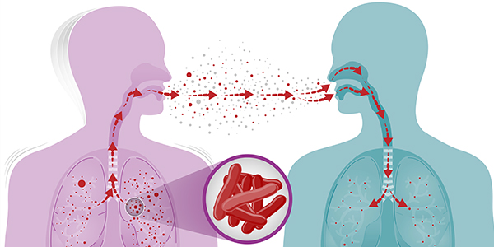
Incidence of Tuberculosis ( per 100,000 population per year )
Tuberculosis(TB) is a disease caused by germs that are spread from person to person through the air. TB usually affects the lungs, but it can also affect other parts of the body, such as the brain, the kidneys, or the spine. A person with TB can die if they do not get treatment. The symptoms of TB disease of the lungs also include coughing, chest pain, and the coughing up of blood. TB disease can be treated by taking several drugs for 6 to 12 months. It is very important that people who have TB disease finish the medicine and take the drugs exactly as prescribed.

Slide 44
Year | China | Japan | South Korea
2000 | 107 [ 61 – 167 ] | 36 [ 31 – 41 ] | 50 [ 46 – 53 ]
2001 | 104 [ 62 – 157 ] | 32 [27 – 37 ] | 85 [ 79 – 91 ]
2002 | 100 [ 62 – 147 ] | 30 [ 25 – 34 ] | 79 [ 74 – 84 ]
2003 | 97 [ 63 – 138 ] | 29 [24 – 33 ] | 83 [ 77 – 89 ]
2004 | 94 [64 – 129 ] | 27 [ 23 – 31 ] | 78 [ 72 - 83 ]
2005 | 91 [ 64 – 121 ] | 24 [ 21 – 28 ] | 96 [ 89 – 103 ]
2006 | 88 [ 65 – 114 ] | 23 [ 19 – 26 ] | 94 [ 87 – 100 ]
2007 | 85 [ 65 -107 ] | 22 [19 – 26 ] | 93 [ 86 – 99 ]
2008 | 82 [ 66 – 101 ] | 22 [ 19 – 25 ] | 90 [ 83 – 96 ]
2009 | 81 [ 65 – 99 ] | 21 [18 – 25 ] | 95 [ 89 – 102 ]
2010 | 76 [ 62 – 91 ] | 20 [ 17 – 24 ] | 97 [ 90 – 103 ]
2011 | 55 [ 47 – 63 ] | 20 [ 17 – 23 ] | 101 [ 94 – 108 ]
2012 | 57 [ 49 – 66 ] | 19 [ 16 – 22 ] | 94 [ 88 – 101 ]
2013 | 58 [50 – 67 ] | 18 [ 16 – 21 ] | 89 [ 83 – 95 ]
2014 | 61 [ 51 – 71 ] | 18 [ 15 – 20 ] | 85 [ 79 – 91 ]
2015 | 62 [ 53 – 73 ] | 17 [ 14 – 19 ] | 79 [ 73 - 84 ]
2016 | 63 [ 53 – 74 ] | 16 [14 – 18 ] | 76 [ 71 – 81 ]
2017 | 62 [ 53 – 73 ] | 15 [ 13 – 18 ] | 69 [ 65 – 74 ]
2018 | 61 [ 51 – 71 ] | 14 [ 12 – 16 ] | 64 [ 60 -69 ]
2019 | 58 [ 50 – 67 ] | 13 [ 11 – 15 ] | 58 [ 54 – 62 ]
2020 | 57 [ 49 – 66 ] | 12 [ 10 – 14 ] | 48 [ 44 – 51 ]
2021 | 55 [ 47 – 63 ] | 11 [ 9.1 – 12 ] | 44 [ 41 – 47 ]

Slide 45
The incidence rate gradually decreased between 2000 and 2021 in Japan & China. South Korea peaked in 2011, with an incidence rate of 101 per 100,000 population. The incidence rate dipped after 2011 and then continued to reduce. Mongolia shows the same value 428 [220 – 703] for 2000 to 2019 & 428 [ 216 – 711 ] for 2020 to 2021. North Korea shows the same value 513 [446 – 584] for 2000 to 2019 & 513 [441 – 590] for 2020 to 2021. Those two values have big difference when comparing with other countries . WHO mentioned that the reason for that constant values is estimates are based on annual case notifications and on information from death (vital) registration systems.

Slide 46
What is Obesity and Underweight ?
Unusual, unnecessary fat accumulation, posing a health risk
State of having obesity is known as obese
For obese people, BMI ≥ 30
Main cause: consuming more and less active
Having BMI < 18.5 is considered “Underweight”
Main cause: malnutrition and lower calorie intake

Slide 47
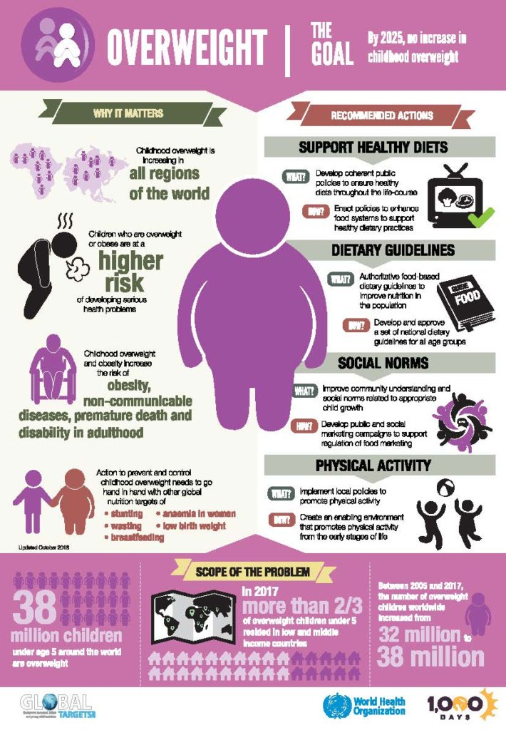
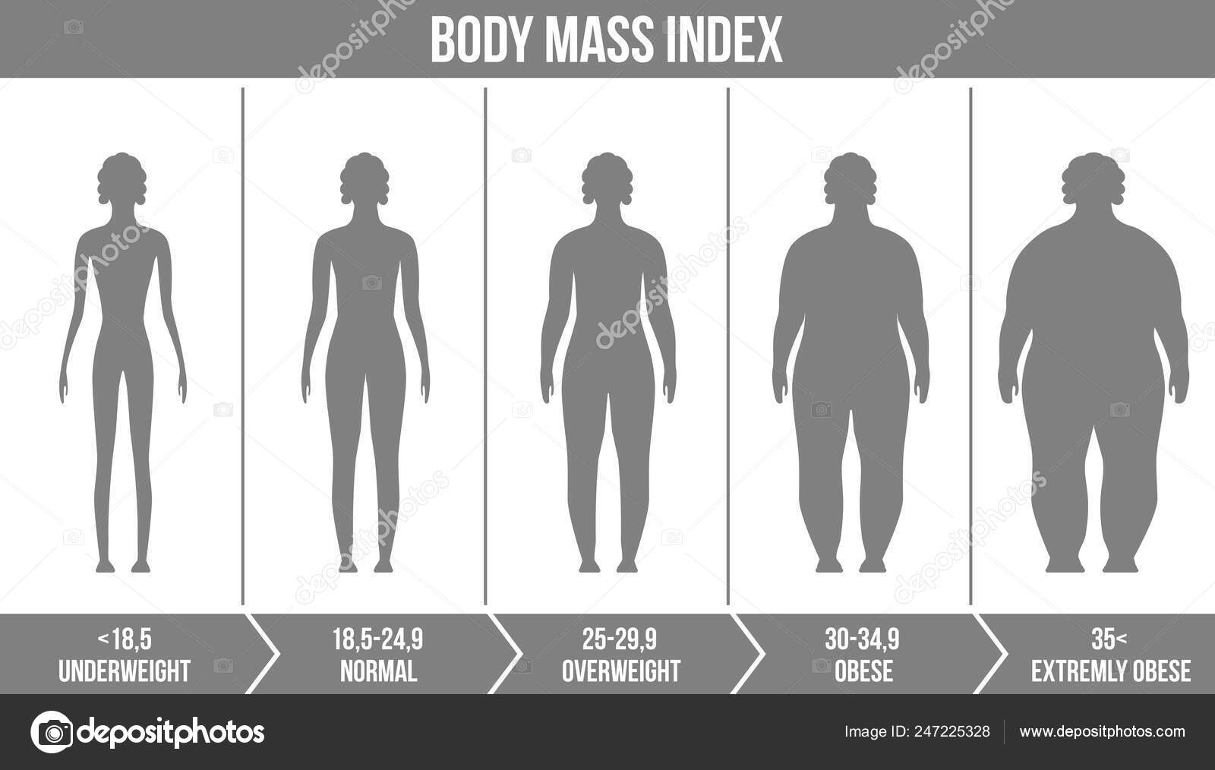

Slide 49
Year | China | Japan | Mongolia | North Korea | South Korea
2016 | 6.2 [4.7 – 7.9] | 4.3 [3.2 – 5.5] | 20.6 [16.3 – 25] | 6.8 [4 – 10.1] | 4.7 [3.6 – 5.9]
2015 | 5.9 [4.5 – 7.4] | 4.1 [3.2 – 5.3] | 19.9 [15.9 – 24.1] | 6.5 [3.9 – 9.8] | 4.5 [3.5 – 5.7]
2014 | 5.5 [4.4 – 6.9] | 3.9 [3.1 – 5] | 19.2 [15.4 – 23.2] | 6.3 [3.8 – 9.4] | 4.4 [3.4 – 5.5]
2013 | 5.2 [4.2 – 6.5] | 3.8 [3 – 4.7] | 18.6 [14.9 – 22.5] | 6.1 [3.7 – 9.1] | 4.3 [3.4 – 5.3]
2012 | 5 [4 – 6.1] | 3.6 [2.9 – 4.5] | 17.9 [14.4 – 21.6] | 5.9 [3.6 – 8.9] | 4.1 [3.3 – 5.1]
2011 | 4.7 [3.8 – 5.7] | 3.5 [2.8 – 4.3] | 17.3 [13.9 – 20.9] | 5.7 [3.5 – 8.5] | 4 [3.2 – 4.9]
2010 | 4.4 [3.6 – 5.3] | 3.3 [2.7 – 4] | 16.7 [13.4 – 20.2] | 5.5 [3.4 – 8.3] | 3.9 [3.1 – 4.8]
2009 | 4.1 [3.4 – 5] | 3.2 [2.6 – 3.8] | 16.1 [12.9 – 19.4] | 5.4 [3.3 – 8] | 3.8 [3 – 4.6]
2008 | 3.9 [3.2 – 4.7] | 3 [2.5 – 3.6] | 15.5 [12.3 – 18.8] | 5.2 [3.2 – 7.7] | 3.7 [2.9 – 4.5]
2007 | 3.7 [3.1 – 4.4] | 2.9 [2.4 – 3.4] | 14.9 [11.8 – 18.1] | 5 [3.1 – 7.5] | 3.6 [2.9 – 4.4]
2006 | 3.4 [2.9 – 4.1] | 2.7 [2.3 – 3.3] | 14.3 [11.3 – 17.5] | 4.9 [3 – 7.3] | 3.5 [2.8 – 4.3]
2005 | 3.2 [2.7 – 3.8] | 2.6 [2.2 – 3.1] | 13.8 [10.8 – 16.9] | 4.7 [2.9 – 7.1] | 3.4 [2.7 – 4.1]
2004 | 3 [2.5 – 3.6] | 2.5 [2.1 – 2.9] | 13.3 [10.4 – 16.3] | 4.6 [2.8 – 6.9] | 3.3 [2.6 – 4]
2003 | 2.8 [2.4 – 3.4] | 2.4 [2 – 2.8] | 12.8 [10 – 15.8] | 4.4 [2.7 – 6.7] | 3.2 [2.5 – 3.9]
2002 | 2.7 [2.2 – 3.2] | 2.2 [1.9 – 2.7] | 12.3 [9.6 – 15.4] | 4.3 [2.6 – 6.5] | 3.1 [2.4 – 3.8]
2001 | 2.5 [2.1 – 3] | 2.2 [1.8 – 2.6] | 11.9 [9.2 – 15] | 4.2 [2.5 – 6.3] | 3 [2.3 – 3.7]
2000 | 2.4 [2 – 2.8] | 2.1 [1.7 – 2.5] | 11.6 [8.9 – 14.6] | 4 [2.4 – 6.2] | 2.9 [2.2 – 3.6]

Slide 50
Interpretation
Prevalence percentages have gradually increased
The highest percentages from Mongolia, (between 11% - 21%)
The lowest from Japan, (between 1% - 6%)

Slide 51
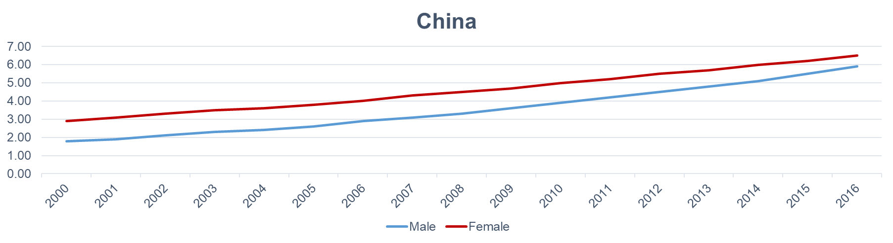
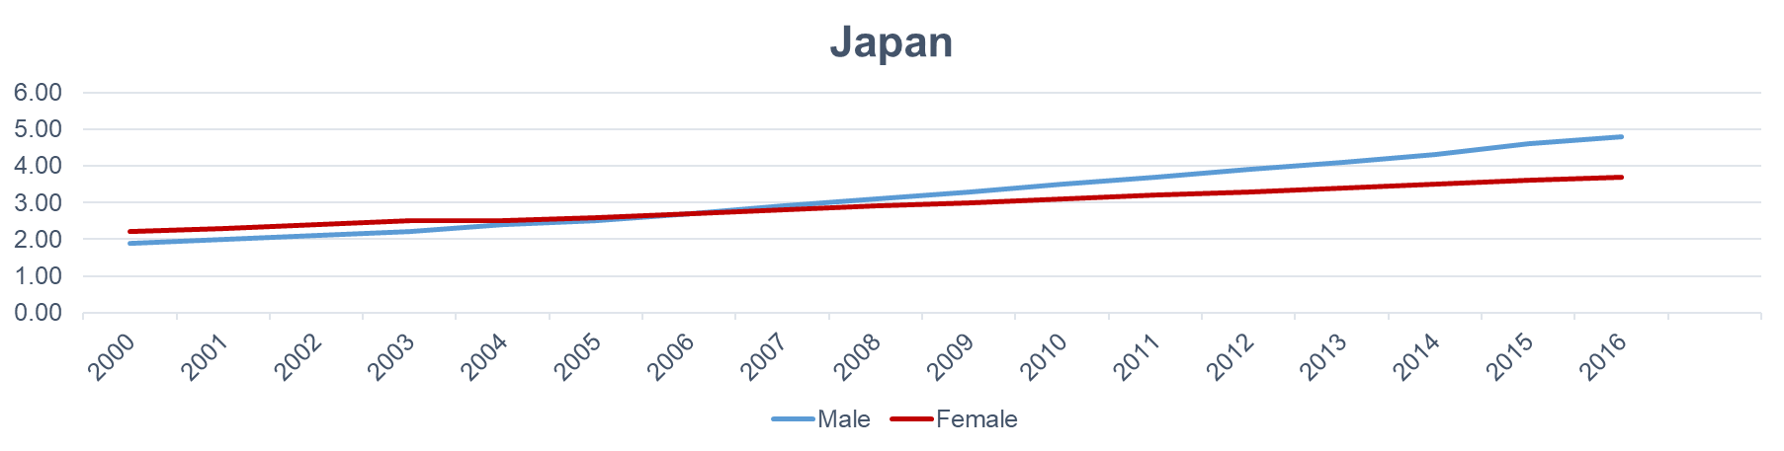

Slide 52
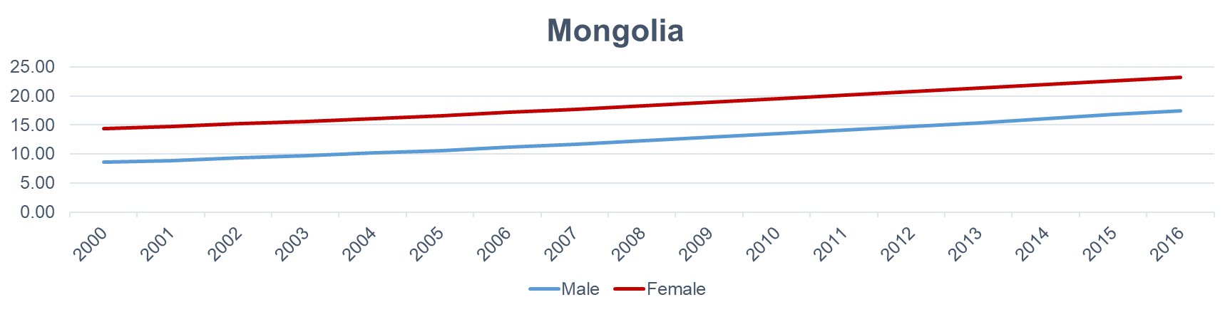
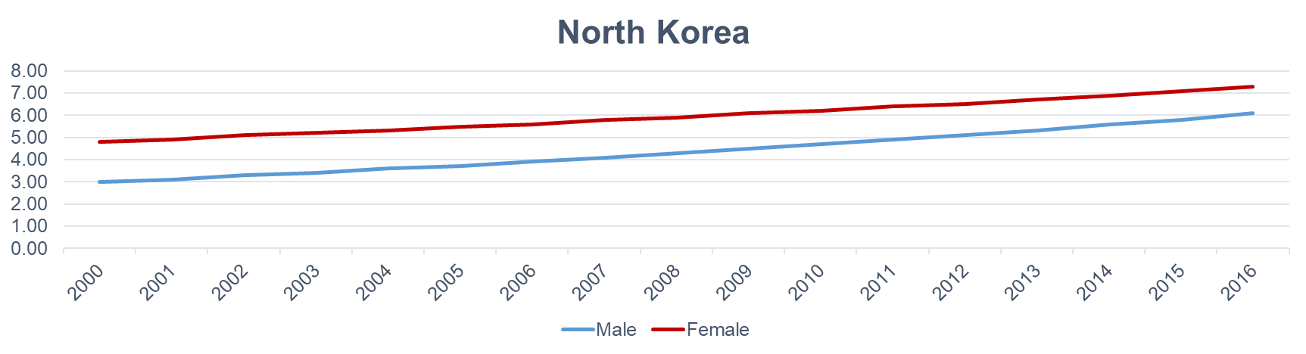

Slide 53
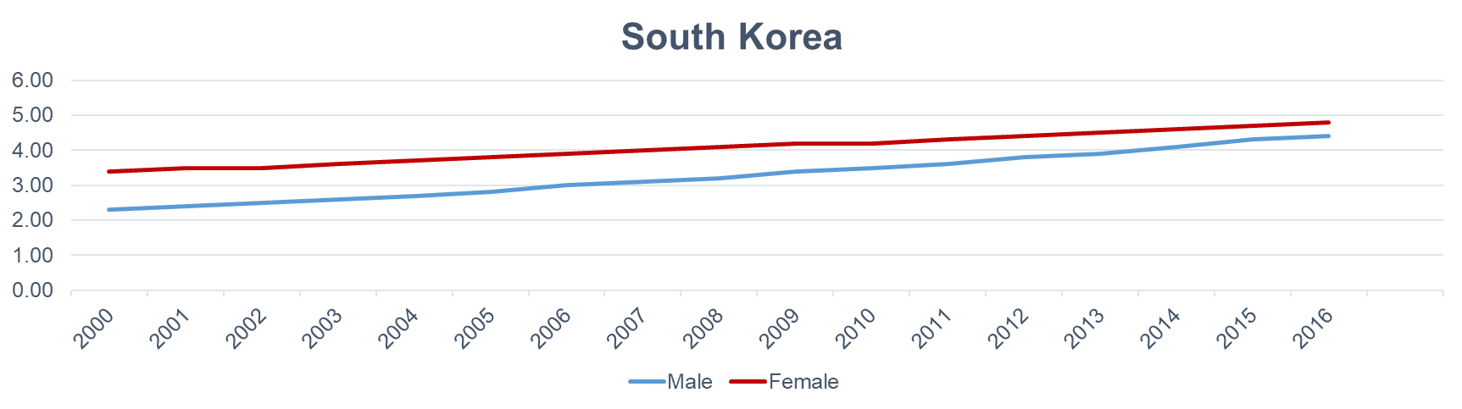

Slide 54
Interpretation
Gradual increase in prevalence for all genders
In Japan percentages for males were higher than that of females after 2006
On or before 2006, vise versa
Prevalence difference between genders, approximately same for Mongolia.

Slide 55
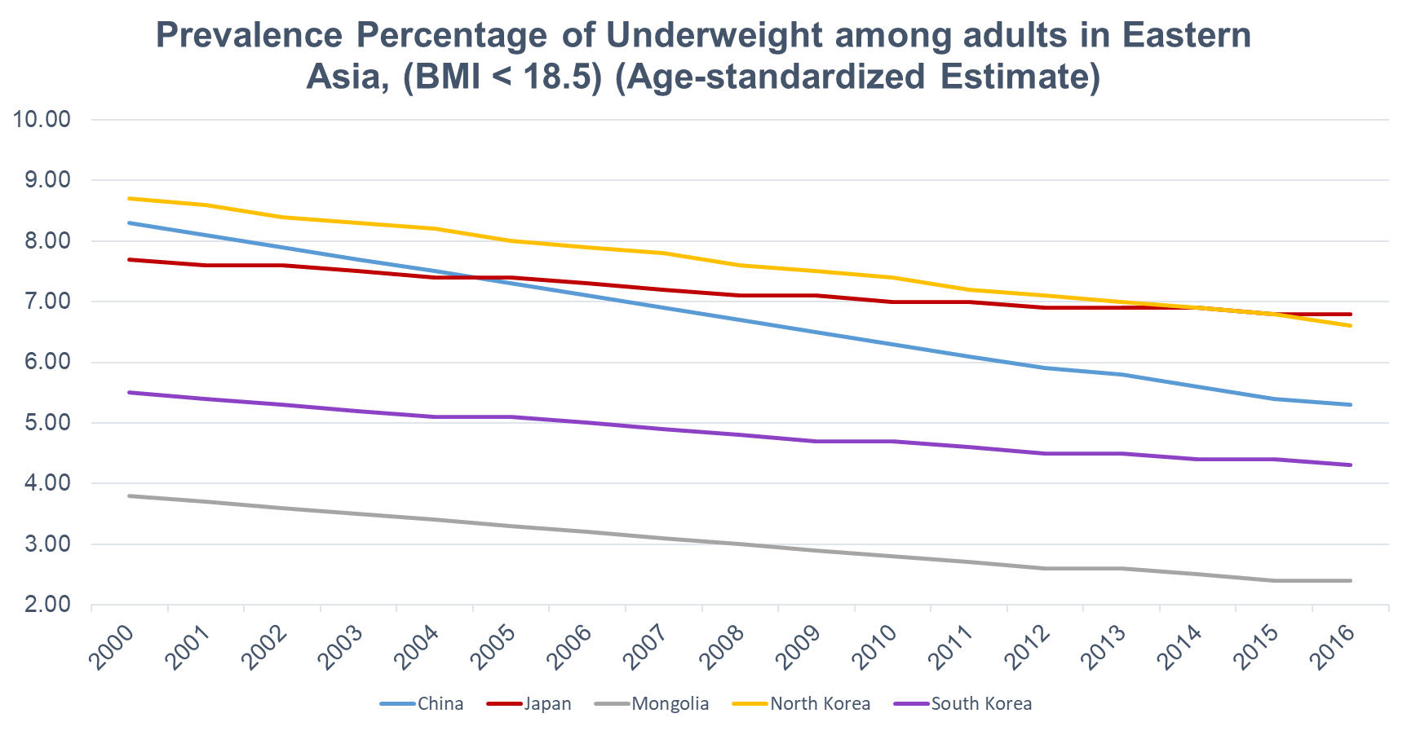

Slide 56
Year | China | Japan | Mongolia | North Korea | South Korea
2016 | 5.3 [3.9 – 6.9] | 6.8 [5.1 – 8.9] | 2.4 [1.4 – 3.8] | 6.6 [3.1 – 12.2] | 4.3 [3.2 – 5.6]
2015 | 5.4 [4.1 – 7] | 6.8 [5.2 – 8.7] | 2.4 [1.4 – 3.9] | 6.8 [3.1 – 12.2] | 4.4 [3.3 – 5.6]
2014 | 5.6 [4.3 – 7.1] | 6.9 [5.4 – 8.6] | 2.5 [1.5 – 3.9] | 6.9 [3.2 – 12.3] | 4.4 [3.4 – 5.6]
2013 | 5.8 [4.5 – 7.2] | 6.9 [5.5 – 8.5] | 2.6 [1.6 – 4] | 7 [3.3 – 12.4] | 4.5 [3.5 – 5.6]
2012 | 5.9 [4.8 – 7.3] | 6.9 [5.6 – 8.5] | 2.6 [1.6 – 4.1] | 7.1 [3.4 – 12.5] | 4.5 [3.6 – 5.6]
2011 | 6.1 [5 – 7.4] | 7 [5.7 – 8.4] | 2.7 [1.7 – 4.2] | 7.2 [3.5 – 12.6] | 4.6 [3.7 – 5.7]
2010 | 6.3 [5.2 – 7.5] | 7 [5.8 – 8.4] | 2.8 [1.8 – 4.3] | 7.4 [3.7 – 12.8] | 4.7 [3.7 – 5.7]
2009 | 6.5 [5.4 – 7.7] | 7.1 [5.9 – 8.4] | 2.9 [1.8 – 4.4] | 7.5 [3.7 – 12.9] | 4.7 [3.8 – 5.8]
2008 | 6.7 [5.6 – 7.9] | 7.1 [6 – 8.4] | 3 [1.9 – 4.5] | 7.6 [3.8 – 13.1] | 4.8 [3.9 – 5.8]
2007 | 6.9 [5.9 – 8.1] | 7.2 [6.1 – 8.4] | 3.1 [2 – 4.6] | 7.8 [3.9 – 13.2] | 4.9 [4 – 5.9]
2006 | 7.1 [6.1 – 8.2] | 7.3 [6.2 – 8.5] | 3.2 [2 – 4.7] | 7.9 [4 – 13.4] | 5 [4 – 6]
2005 | 7.3 [6.3 – 8.4] | 7.4 [6.3 – 8.5] | 3.3 [2.1 – 4.9] | 8 [4.1 – 13.6] | 5.1 [4.1 – 6.1]
2004 | 7.5 [6.4 – 8.7] | 7.4 [6.4 – 8.6] | 3.4 [2.2 – 5.1] | 8.2 [4.2 – 13.8] | 5.1 [4.1 – 6.3]
2003 | 7.7 [6.6 – 8.9] | 7.5 [6.5 – 8.6] | 3.5 [2.2 – 5.2] | 8.3 [4.3 – 14] | 5.2 [4.2 – 6.4]
2002 | 7.9 [6.8 – 9.1] | 7.6 [6.6 – 8.7] | 3.6 [2.3 – 5.4] | 8.4 [4.3 – 14.1] | 5.3 [4.2 – 6.5]
2001 | 8.1 [7 – 9.3] | 7.6 [6.7 – 8.7] | 3.7 [2.4 – 5.6] | 8.6 [4.4 – 14.3] | 5.4 [4.3 – 6.6]
2000 | 8.3 [7.2 – 9.6] | 7.7 [6.7 – 8.8] | 3.8 [2.4 – 5.7] | 8.7 [4.5 – 14.5] | 5.5 [4.3 – 6.8]

Slide 57
Interpretation
Percentages have decreased over time
The lowest from Mongolia during 16 years period
The highest recorded from North Korea until 2014
After 2014 Japan had the highest
For South Korea it varied 6% - 4%
Chain has the highest varying prevalence

Slide 58
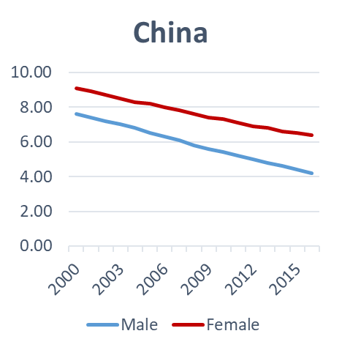
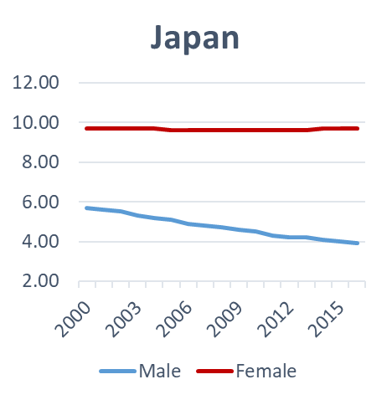
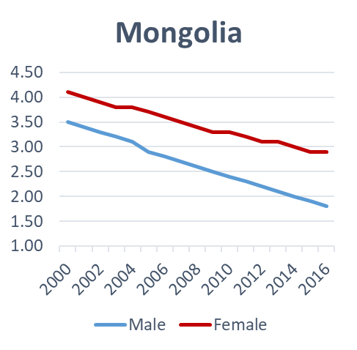
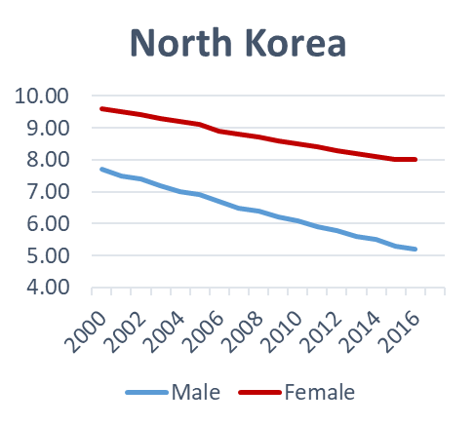
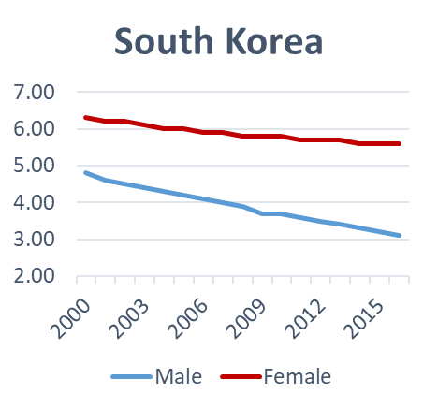

Slide 59
Interpretation
Decreased for all genders
Percentages in females were higher than that in males

Slide 60
References
https://data.worldbank.org/
https://www.who.int/data/gho/data/indicators
https://www.worldlifeexpectancy.com/
https://www.mayoclinic.org/diseases-conditions/obesity/symptoms-causes/syc-20375742

